Slide 1
LaValle, Steven M. "Rapidly-Exploring Random Trees A Цew Tool for Path Planning." (1998)
RRT Navigation

Slide 2
Problem Statement
How can we solve complex navigation problems in continuous space?
Complex:
Many dimensions: X, Y, Z, theta
Continuous:
Avoid discretization

Slide 3
Difficulties with other approaches
Discretized solutions, e.g., A-star in grid world
Coarse grids don’t allow optimal plans
Fine grids become complex
Most previous solutions don’t do well in high dimensional spaces

Slide 4
Solution
Randomly grow a tree in continuous space
Root of the tree is starting location
When tree touches goal region we have a solution

Slide 5
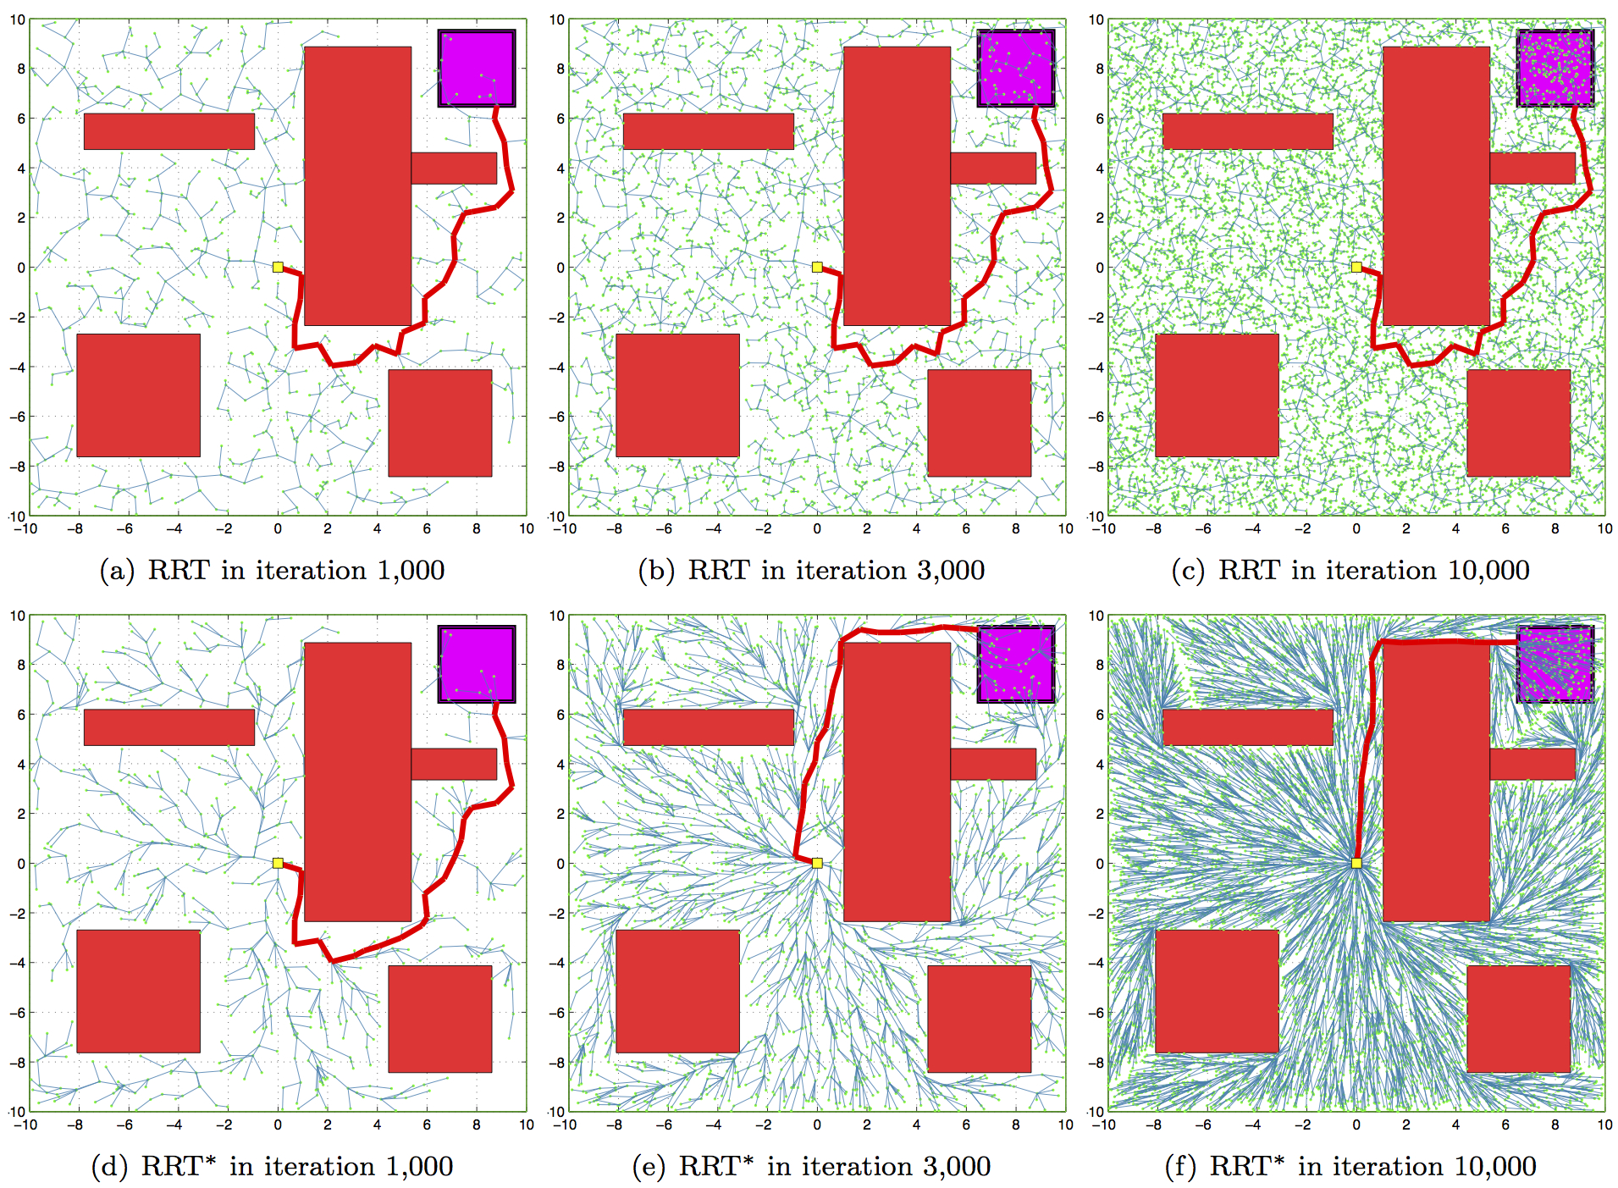
Solution

Slide 6
Solution
Randomization
Goal

Slide 7
Solution
Improvement: Biases
Bias towards open spaces
Bias towards goal
– When generating a random sample, with some probability pick the goal instead of a random node when expanding
– This introduces another parameter
– James’experience is that 5-10% is the right choice
Provides faster convergence, better path solutions

Slide 8
Solution: + Bias
Randomization
Goal

Slide 9
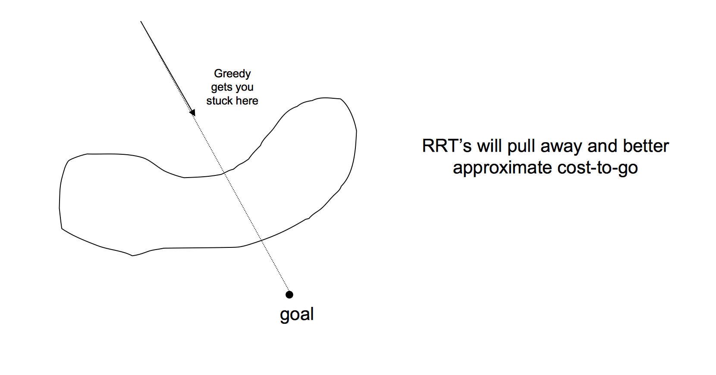
Challenge

Slide 10
Solution

Slide 11
Experimental Methodology
Not applicable for this paper

Slide 12
Experimental Results
Not applicable for this paper

Slide 13
Example Videos

Slide 14
Strengths
Fast
Continuous
High dimensionality

Slide 15
Weaknesses
Solution not guaranteed
Solution not necessarily optimal

Slide 16
Questions?

